Slide 1
Lesson 18
Know how to compute numerically a
derivate of a function
Be aware of numerical problems

Slide 2
Numerical differentiation

Slide 3
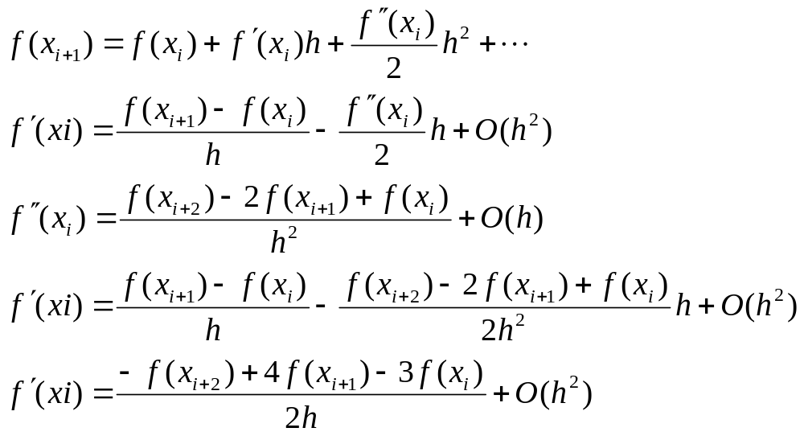
High Accuracy Differentiation Formulas
High-accuracy divided-difference formulas can be generated by including additional terms from the Taylor series expansion.

Slide 4
Inclusion of the 2nd derivative term has improved the accuracy to O(h²).
Similar improved versions can be developed for the backward and centered formulas as well as for the approximations of the higher derivatives.

Slide 5
Numerical problems
In numerical differentiation one does exactly what should be avoided in numerics: subtraction of nearly two equal numbers. This is the greatest difficulty in numerical differentiation, but it is essentially impossible to avoid it.

Slide 6
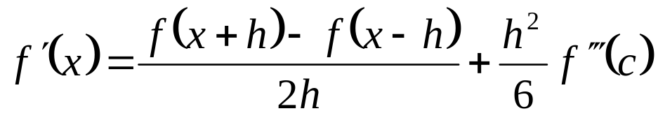

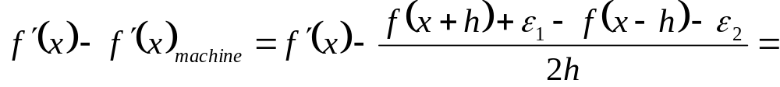
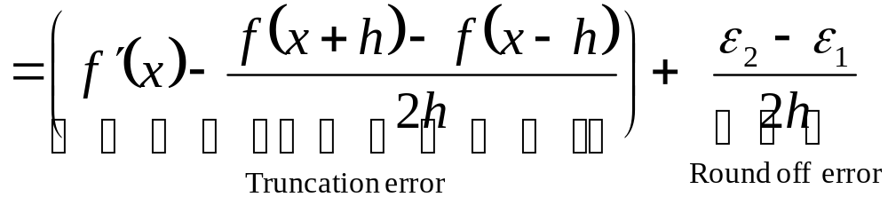
Example
with
Estimation of the round-off errors:

Slide 7
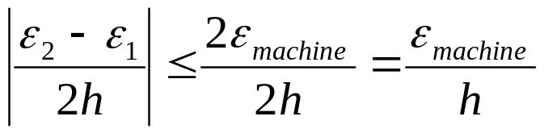
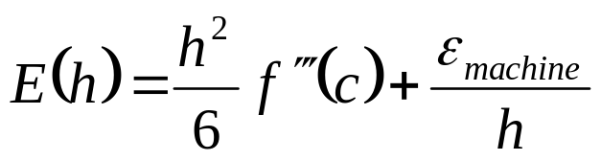
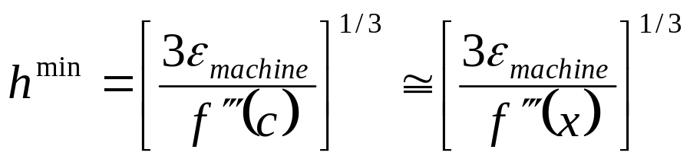
In summary
Round-off error bounded by:
Therefore:
Which has a minimum at:

Slide 8
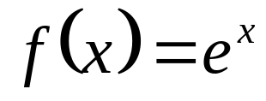
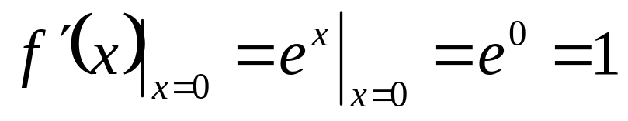
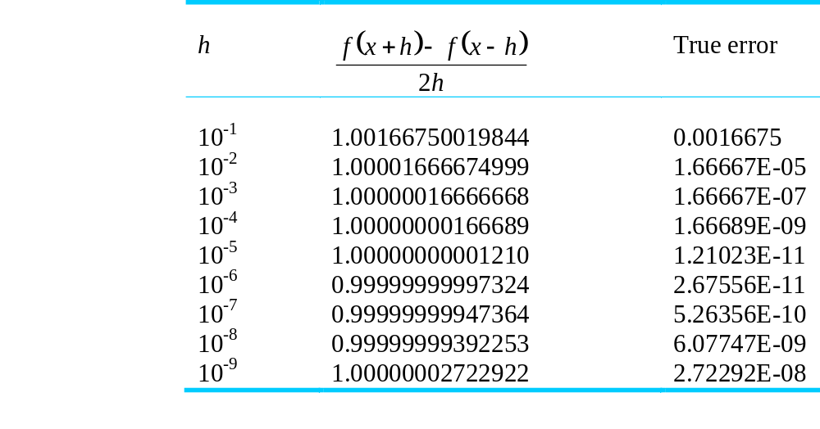
An example
Let us compute the derivate of
at x=0
Correct value is:

Slide 9
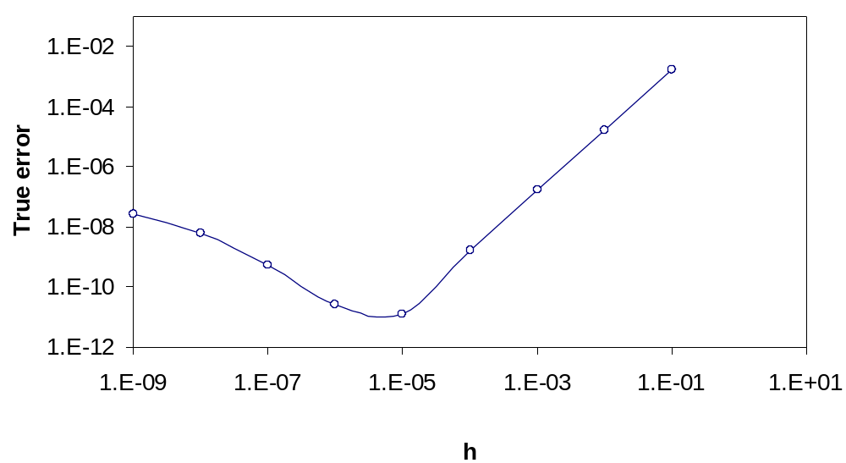
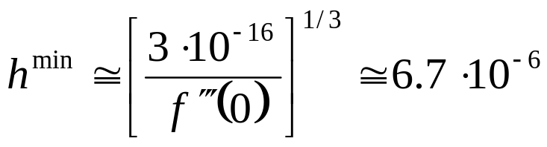

Slide 10
Richardson Extrapolation
There are two ways to improve derivative estimates when employing finite divided differences:
  Decrease the step size, or
  Use a higher-order formula that employs more points.
A third approach, based on Richardson extrapolation, uses two derivative estimates to compute a third, more accurate approximation.

Slide 11
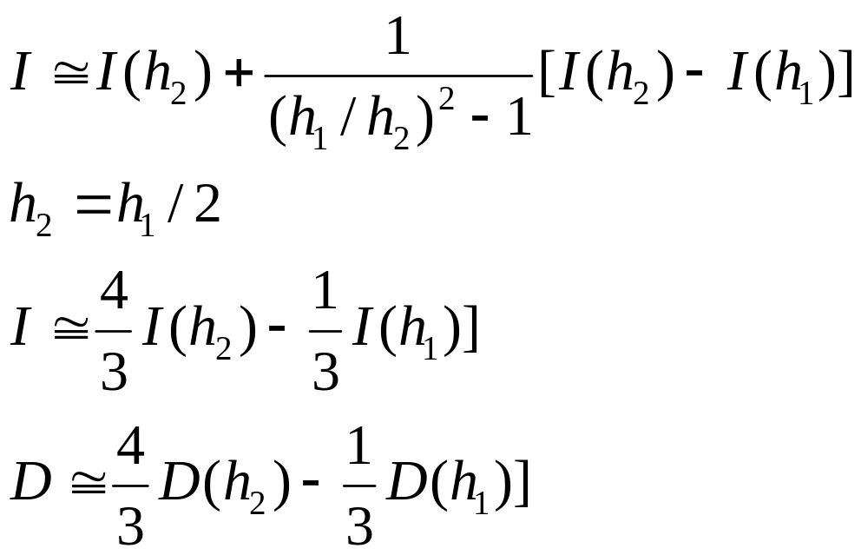
For centered difference approximations with O(h²). The application of this formula yield a new derivative estimate of O(h⁴).

Slide 12
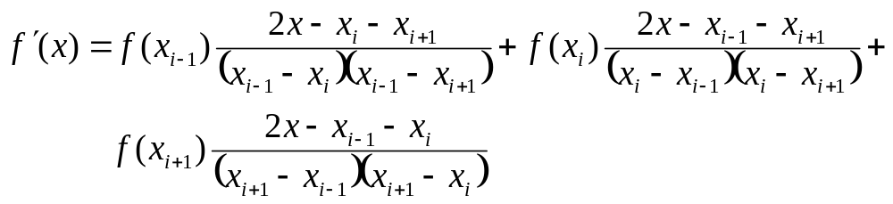
Derivatives of Unequally Spaced Data
Data from experiments or field studies are often collected at unequal intervals. One way to handle such data is to fit a second-order Lagrange interpolating polynomial.
x is the value at which you want to estimate the derivative.

Slide 13
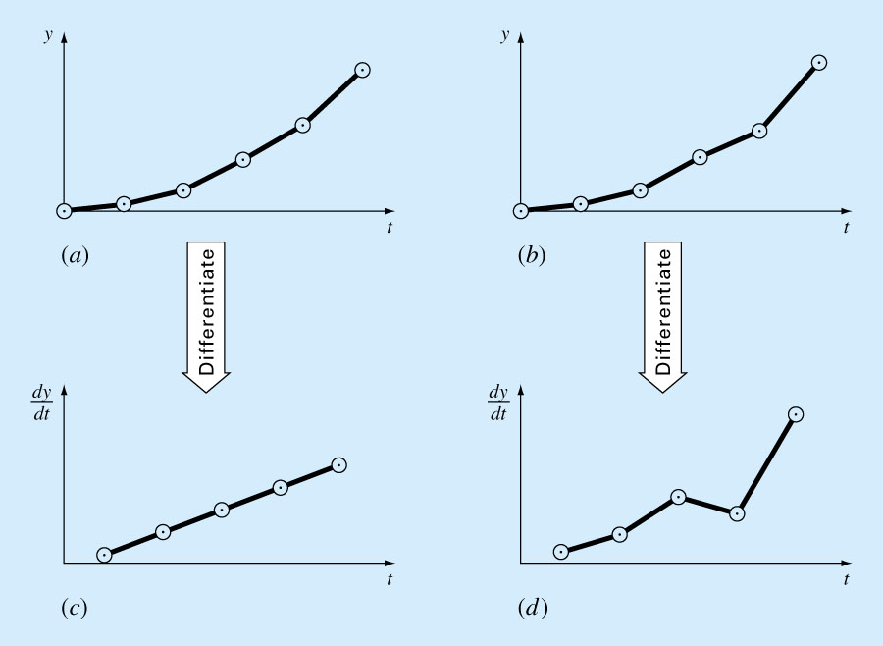
Derivatives and Integrals for Data with Errors

